Slide 1
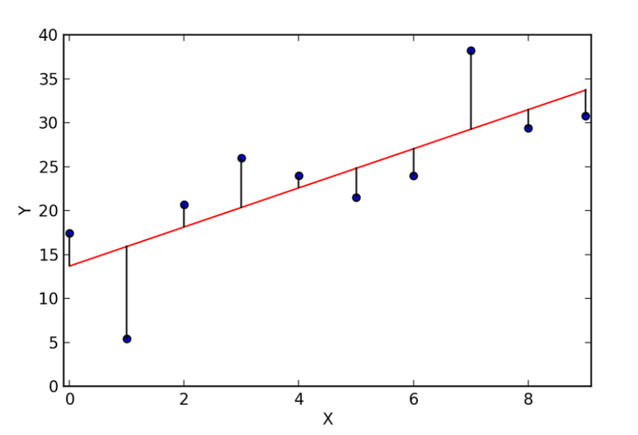
Recall of linear regression line
As we know that in linear regression to find the best fitting we start with some data and we fit a line to them using the least-squares i.e. we measure the residuals (the distance between the data and the line) then square them, so that negative values do not cancel out positive values. Then we rotate the line a little bit and do the same. The line with the smallest sum of squared residuals is the line chosen to fit best.

Slide 2
Why can’t we make use of least-squares to find the best fitting line in logistic regression?
Our goal in logistic regression is to draw the best fitting S-curve for given data points. And in logistic regression, we transform the y-axis from the probabilities to log(odds).
The problem is that this transformation pushes the data points to positive and negative infinity as shown in next slide.

Slide 3
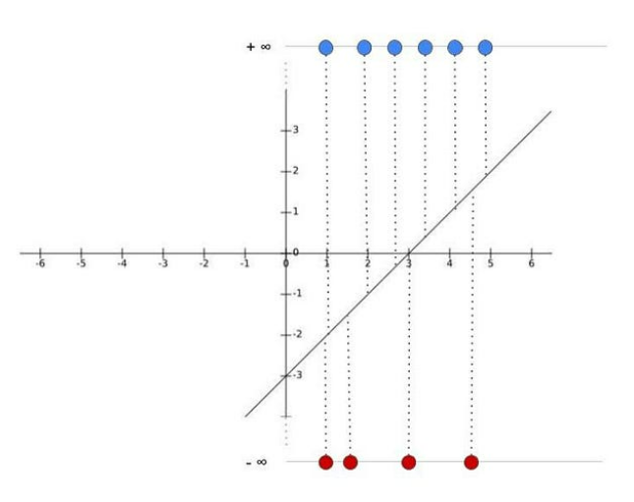
When P ranges from 0 to 1, log odds range between -∞ to +∞
So, we can’t use least-squares to find the best fitting line as the residuals are also equal to positive and negative infinity. Instead of least-squares, we make use of the maximum likelihood to find the best fitting line in logistic regression. Also, in classification problems, we have target values like 0/1. So (Ŷ-Y)² will always be in between 0-1 which can make it very difficult to keep track of the errors and it is difficult to store high precision floating numbers. The cost function used in Logistic Regression is Log Loss.

Slide 4
In Maximum Likelihood Estimation, a probability distribution for the target variable (class label) is assumed and then a likelihood function is defined that calculates the probability of observing the outcome given the input data and the model.
This function can then be optimized to find the set of parameters that results in the largest sum likelihood over the training dataset.
By applying Maximum Likelihood estimation, the first thing we do is project the data points onto the line. This gives each data point a log(odds) value.

Slide 5
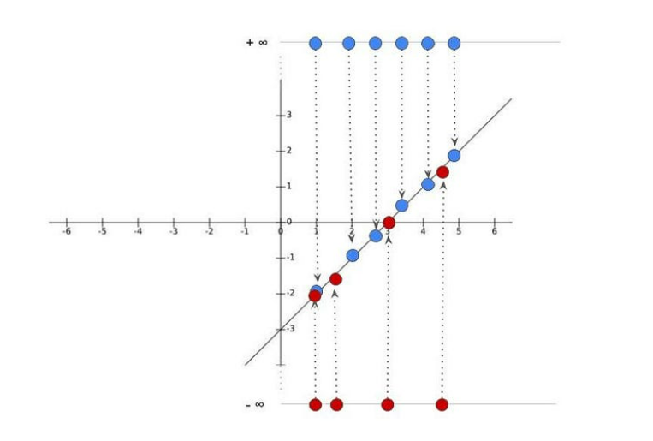
Projection of each data point to the line to give log-odds value

Slide 6
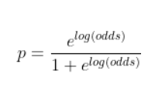
We then transform this log(odds) to probabilities using the above formula.
Once we calculate the probabilities, we will plot them to get an s-curve. Now, we just keep rotation the log(odds) line and projecting the data points onto it and then transforming it to probabilities and calculating the log-likelihood. This process is repeated until we maximize the log-likelihood.

Slide 7
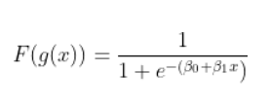
Estimation of Log-likelihood function
The logistic regression equation is given as –
The parameters to be estimated in the equation of a logistic regression are β vectors.
To estimate β vectors let us consider N samples with labels either 0 or 1.
Mathematically, For samples labeled as ‘1’, we try to estimate β such that the product of all probability p(x) is as close to 1 as possible.
And for samples labeled as ‘0’, we try to estimate β such that the product of all probability is as close to 0 as possible in other words (1 — p(x)) should be as close to 1 as possible.

Slide 8
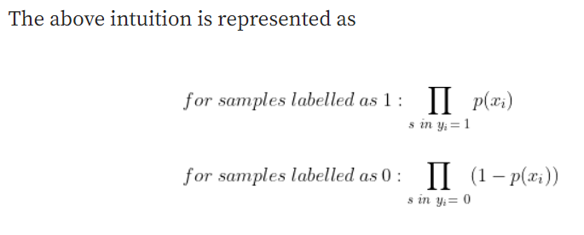
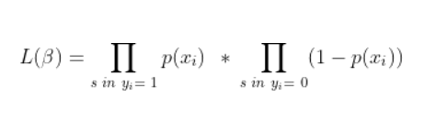
On combining the above conditions, we want to find parameters such that the product of both of these products is maximum over all elements of the dataset. This function is called the Likelihood function.

Slide 9
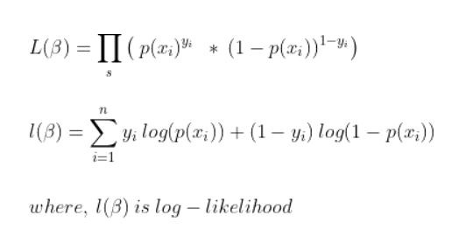
Now, we combine the products and take log-likelihood to simply it further
Since, l(β) = log(L(β)) , so multiplication got converted to addition as shown above.

Slide 10
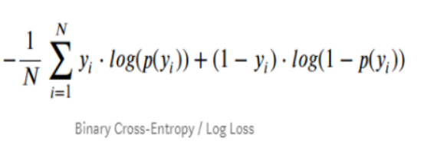
What is Log loss?
Log loss, also known as logarithmic loss or cross-entropy loss, is a common evaluation metric for binary classification models.
Log Loss is the most important classification metric based on probabilities.
For any given problem, a lower log loss value means better predictions.
Formula for log-loss is given below
Here Yi represents the actual class and log(p(yi)) is the probability of that class.
p(yi) is the probability of 1.
(1-p(yi)) is the probability of 0.

Slide 11
Log-odds calculation problem – Solved in class
- Prepared by
Jheelam Mondal
Assistant Professor
CSE Department
Haldia Institute of Technology

